Slide 1

Season Registration 2026/27
Swimtopia
Important Notes on Season Registration
Season Registration on Swimtopia & Season Fees via Flexischools are NOT required for Half Lap swimmers
For 25/50m trial swimmers: You MUST register on Swimtopia prior to swimming (& nominate for races); pay season fees post trial if you are proceeding for the season

Slide 2
Summary of Key Steps
Create Swimtopia account
Enter 2026/27 Season information
  Parent/Guardian information
  Child/ren information
  Other information as requested by the Club
Finalise and Confirmation/Acknowledgement of Registration
Download Swimtopia App (Google Play or Apple)
Pay Season Fees via Flexischools (if haven’t already done so or doing a trail night first)

Slide 3
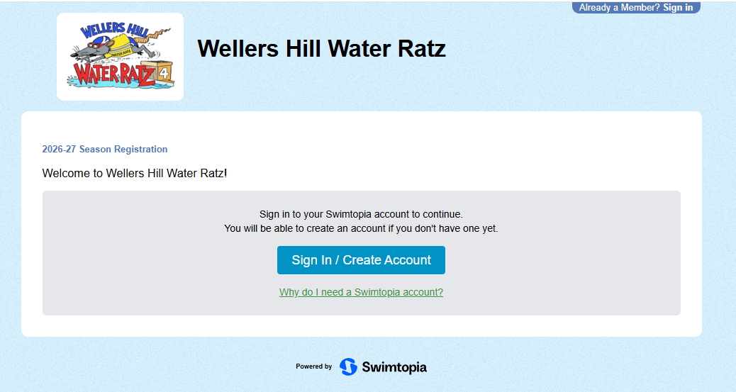

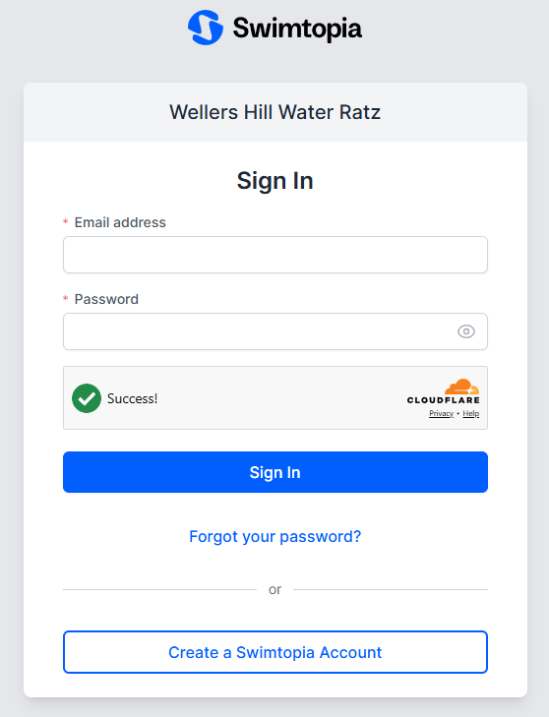
Create Swimtopia account
1
Register via the SwimTopia website https://wellershillwaterratz.swimtopia.com/register
Click ‘Sign In/Create Account’
Click ‘Create a Swimtopia Account’
2

Slide 4
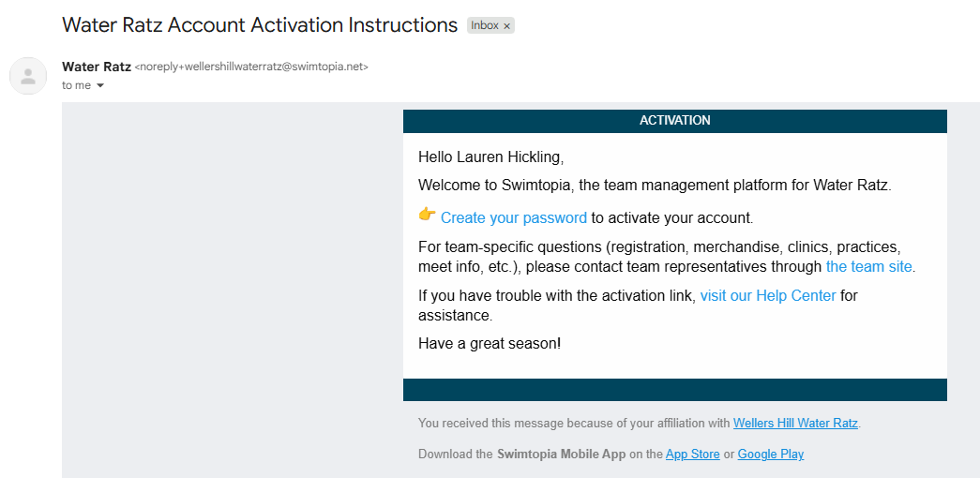
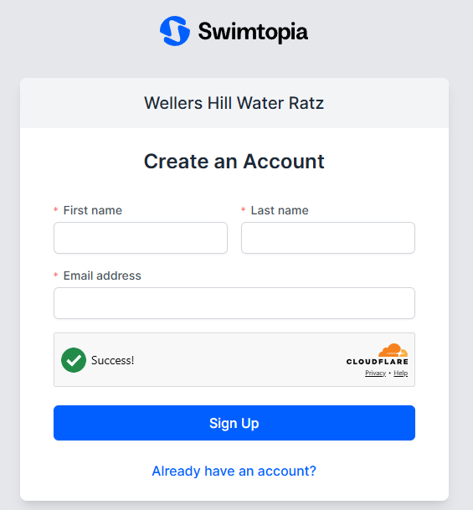
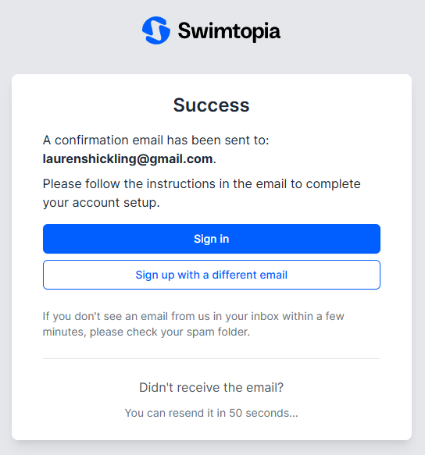
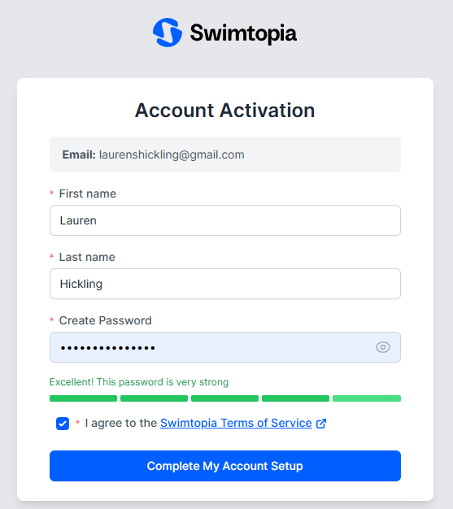
Create Swimtopia account continued
Enter mandatory information then click ‘Sign Up’
After clicking ‘Sign Up’, you’ll see the ‘Success’ screen
Open your email, find the email titled ‘Water Ratz Account Activation Instructions’ and click ‘Create your password’
Enter mandatory information, tick ‘I agree to the Swimtopia Terms of Service’ then ‘Complete My Account Setup’
5
3
4
6

Slide 5
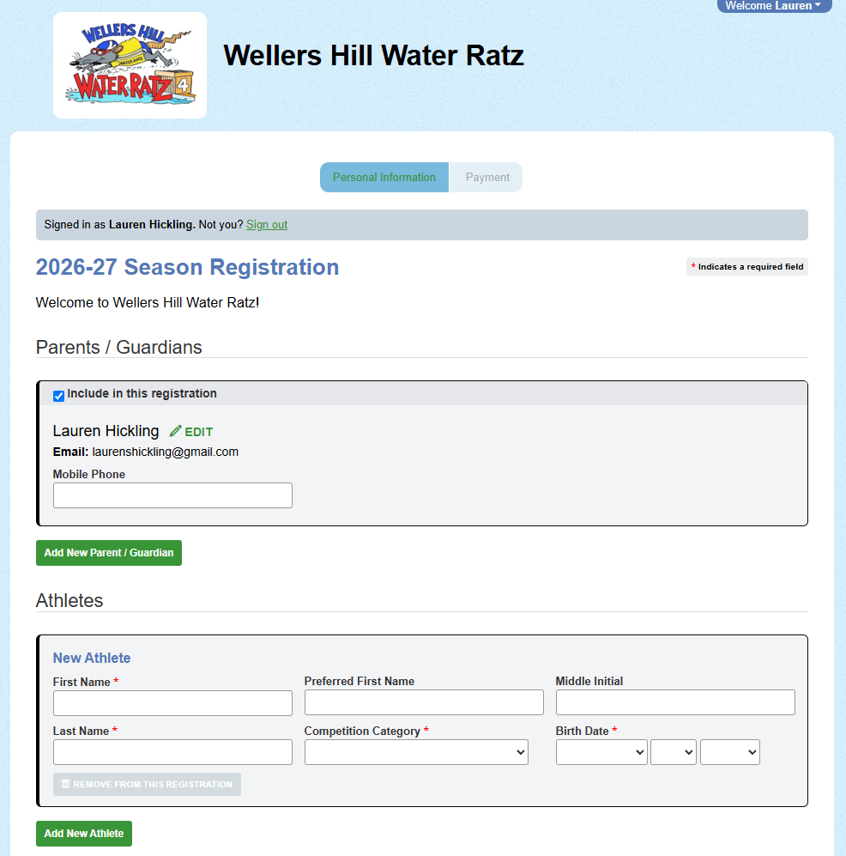
Enter 2026/27 Season information
Parent/Guardian information
Optional: Add New Parent/Guardian (highly recommend doing this now if the child/ren have 2 or more Parents/Guardians who will regularly use the app to nominate races each week &/or see results, receive push notifications via the App etc.
Note: only 1 parent registers the swimmer/s for the season, the other parent creates an account once registration is complete – they will receive an email.
Athlete/Swimmer/s details; click Add New Athlete if registering more than 1 child.
School name/s the Swimmer/s attend
Photo/Video Consent
Acknowledgement of Club Booklet and Club Fees
Click ‘Next’

Slide 6
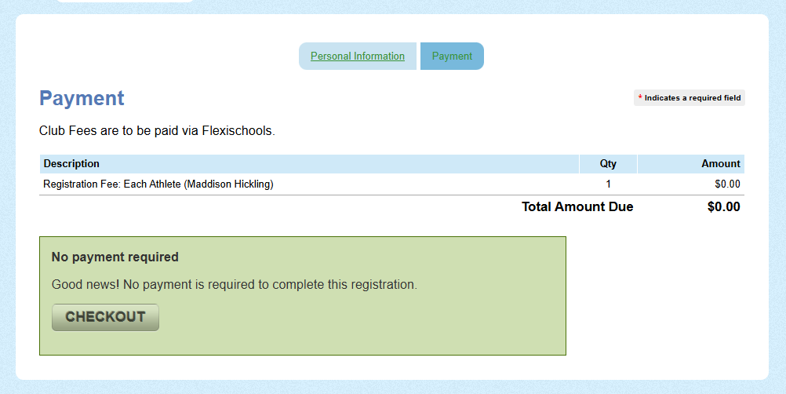
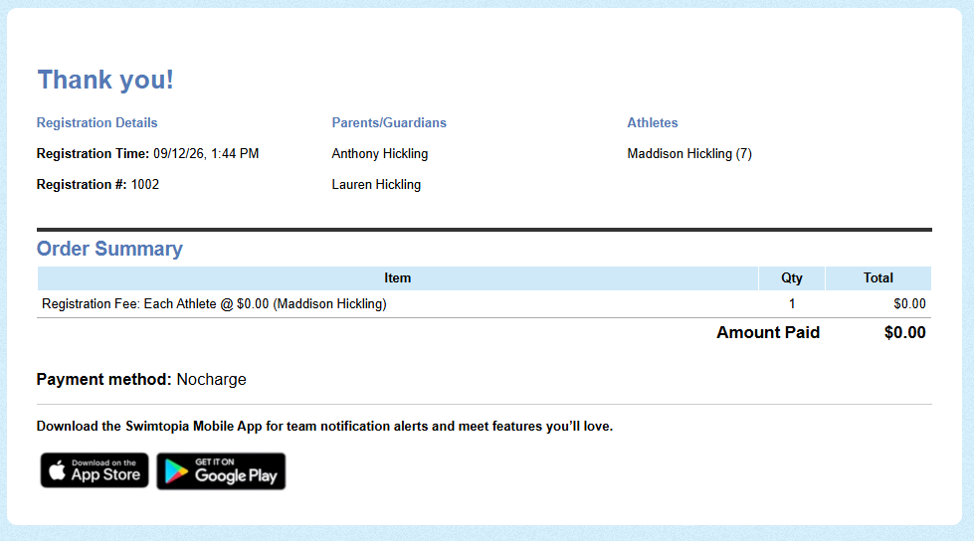
Finalise and Confirmation/Acknowledgement of Registration
Click ‘Checkout’
After clicking ‘Checkout’, you’ll see the ‘Thank you!’ screen

Slide 7
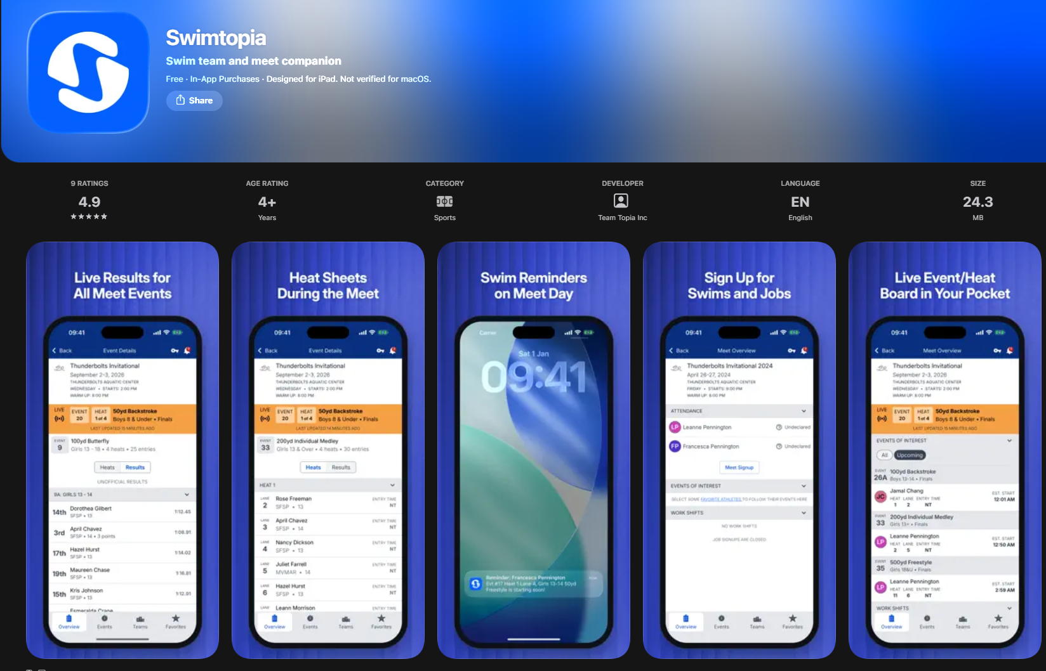
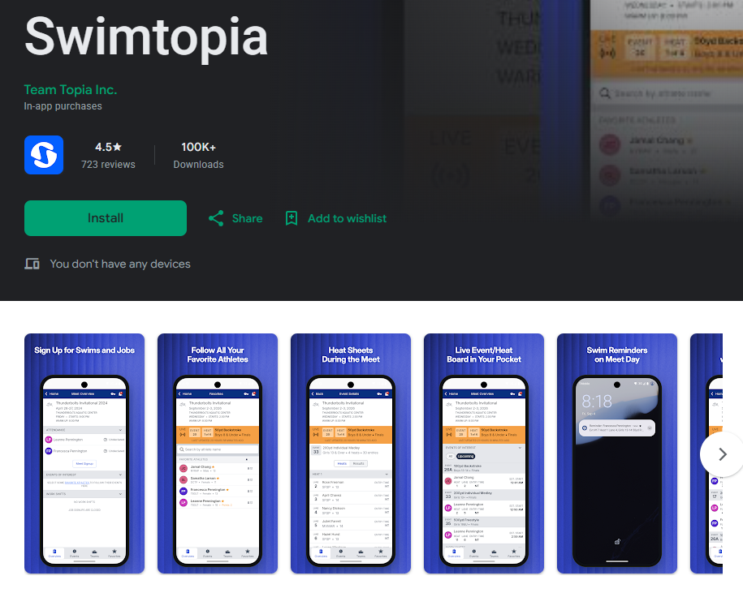
Download Swimtopia App (Google Play or Apple)

Slide 8
Pay Season Fees via Flexischools
Pay Season Fees via Flexischools
https://ordering.flexischools.com.au/m/wellers-hill-state-school-p-c-event-wellers-water-ratz-swim-club
Trial Night swimmers: pay season fees post trial if you are proceeding for the season
Half Lap swimmers: season fees NOT required

